Slide 1
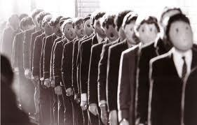
Dystopian Literature
All in all, we’re just another brick in the wall…

Slide 2
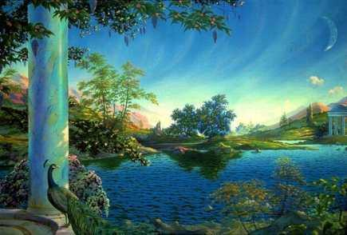
What is a Utopia?
A place, state, or condition that is ideally perfect in respect of politics, laws, customs, and conditions

Slide 3
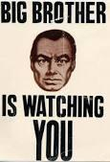
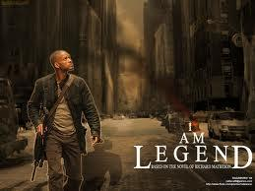
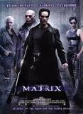
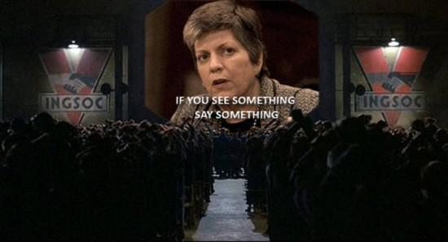
What is a Dystopia?
Futuristic, imagined universe
Oppressive societal control
Perfect society is maintained through corporate, bureaucratic, technological, moral, or totalitarian control
Dystopian literature criticizes current trends, norms, or political systems

Slide 4
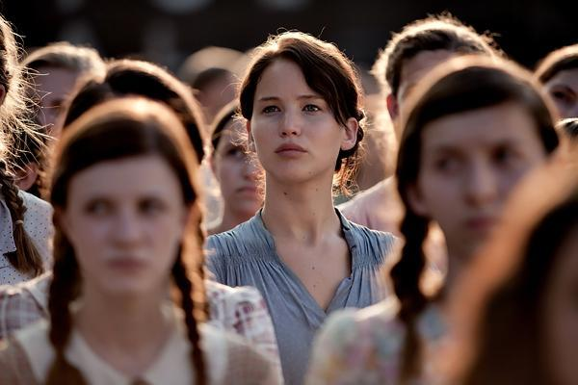
Characteristics of Dystopian Society
Propaganda is used to control citizens
Information, independent thought, and freedom are restricted
Figurehead or concept is worshipped by the citizens of the society
Citizens are under constant surveillance and have a fear of the outside world
Citizens live in a dehumanized state
Notes:
Clicking on the picture will bring up a link for The Hunger Games. Click on the ‘Hunger Games movie trailer #2 (the one with the guards) Since this is a dystopian novel that most kids will know of, it would be a great point of reference for the characteristics of society.

Slide 5
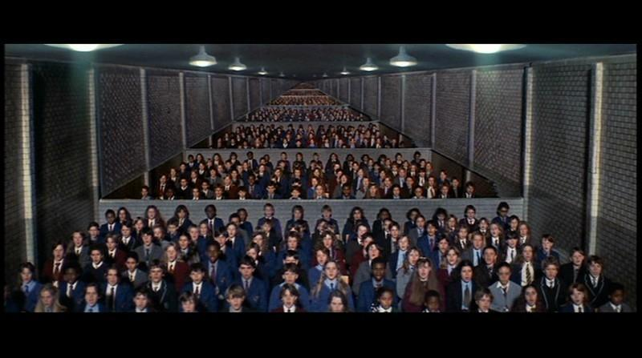
Characteristics of Dystopian Society
The natural world is banished and distrusted
Citizens conform to uniform expectations
Individuality and dissent are bad
Society is an illusion of a perfect utopian world

Slide 6
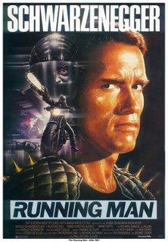
Types of Dystopian Controls
Corporate control:
One of more of the large corporations control society through products, advertising, and the media
Notes:
Clicking on the picture will bring up the link for a trailer of Running Man. The movie is basically the same concept as The Hunger Games--in order to control the population, people are chosen to participate in a game of survival. You can draw the parallel between the stories and talk about recurring themes (ELACC8RL)

Slide 7
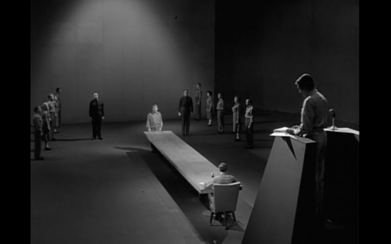
Bureaucratic Control
Society is controlled by a mindless bureaucracy through a tangle of red tape, relentless regulations, and incompetent government officials
Notes:
Clicking on the picture will bring up a Youtube video of The Twilight Zone episode “The Obsolete Man”. Watch through 6:36—Mr. Wordsworth is a librarian, and is found to be obsolete by the leader and his ‘bureaucracy’. They argue over whether something exists even if the bureaucracy doesn’t believe in it. Point of discussion: “You have no function Mr. Wordsworth. You are an anachronism, like a ghost from another time” Wordsworth (metaphorical name) is found to be obsolete and sentenced to “liquidation” (death)

Slide 8
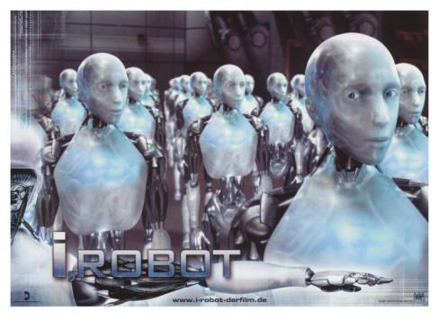
Technological Control
Society is controlled by technology—through computers, robots, and/or scientific means
Examples: The Matrix, The Terminator, and I, Robot
Notes:
Clicking on the I,Robot picture will bring up the link to an Amazon.com page. Click on the “play trailer” button to play the trailer of the movie

Slide 9
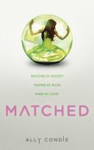
Philosophical/Religious Control
Society is controlled by a philosophical or religious ideology often enforced through a dictatorship or theocratic government
Notes:
Clicking on the picture will bring up a link to the book trailer for “Matched”

Slide 10
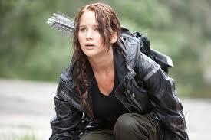
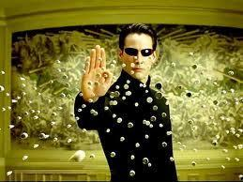
Dystopian Protagonist
Often feels trapped and is struggling to escape
Questions the existing society and political systems
Believes or feels that something is terribly wrong with society in which he or she lives
Helps the audience recognize the negative aspects of the dystopian world through his or her perspective

Slide 11
Optional discussion questions
Why would an author choose to write a novel about a futuristic society with serious and sometimes dangerous faults?
What current trends, or ideas, exist in our world today that the author might be thinking of when writing this type of story?
What benefits do dystopian stories lend to you and your world?

